Slide 1
Assignment 4

Slide 2
Purpose and plan
Purpose | Model type | Datasets | Tests
Understand SLL: evaluation and usefulness of learned representations | Classification | FordA AWR Epilepsy FD-A FD-B | Raw vs. SSL Clean vs. corrupted Masking ablation Transfer learning

Slide 3
SSL methods
T-Loss
Triplet loss
Random length sampling for robustness
Sub-series as positive within context of reference
Other series as negative
Stacked, dilating, convolutional layers and residual connections

Slide 4
SSL methods
TS2Vec
Overlapping series are encoded – same segment is viewed through different contexts
Augment latent representations
Temporal negatives: other timestamps of same series
Instance negatives: other series in the batch at the same timestamp
Hierarchical contrasting: progressively coarser maxpooling for loss calculation
Dilated CNN network

Slide 5
SSL methods
TF-C
Time and frequency representations
Augmentations on raw data
Positives (1st level): augmented views
Negatives (1st level): other series
Positives (2nd level): other domain representation
Negatives (2nd level): augmentations
Architecture: convolutional blocks and fully connected layers

Slide 6
Datasets
Dataset | Source | Channels | Classes | Train | Val. | Test
FordA | Engine noise | 1 | 2 | 3,601 | – | 1,320
Articulary Word Recognition | Mouth motions | 9 | 25 | 275 | – | 300
Epilepsy | Acceleration during phys. act. | 3 | 4 | 137 | – | 138
FD-A | Bearing vibration | 1 | 3 | 8,184 | 2,728 | 2,728
FD-B | Bearing vibration | 1 | 3 | 60 | 21 | 13,559
Train, validation and test: number of series in the official splits. FD-A and FD-B: windows in the processed TF-C data. UCR/UEA datasets have no validation split; tuning uses cross-validation on the training set. The FD-A and FD-B validation files are not loaded by the TF-C code.

Slide 7
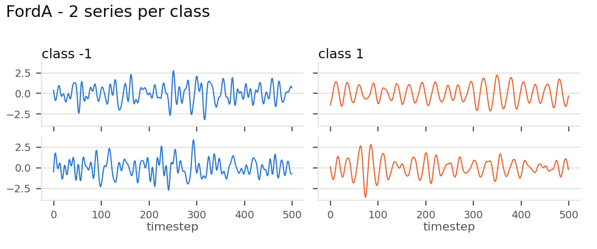
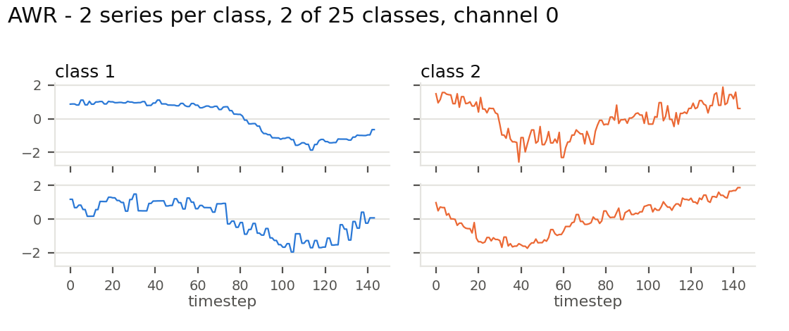
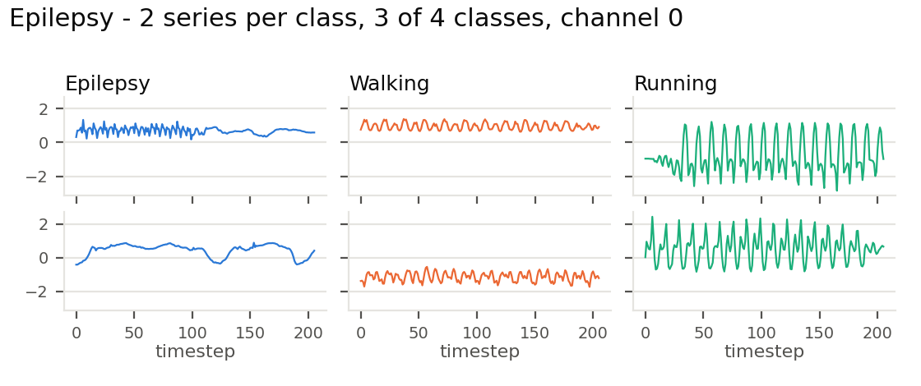
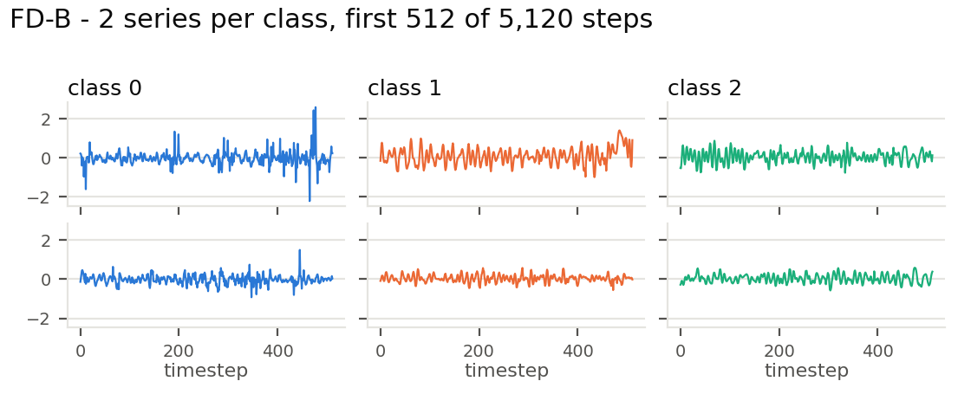
Datasets
Example waveforms from the training splits

Slide 8
Experimental protocol
Pipeline
Accuracy
Raw data
Scaling
Probing
F1-score
Accuracy
Raw data
Scaling
Encoding
Scaling
Probing
F1-score

Slide 9
Experimental protocol
Specifications
Scaling | z-scaling, fitted on training data, per channels and representations | Metrics | Mean and std. of accuracy and macro F1-score
Validation | 5-fold stratified CV for hyperparameter tuning (unless dataset doesn’t allow) | Labels | 10% and 100% of labels in training
Seeds (three) | Folds, 10% label sets, initialisation, corruption pattern, probe’s random state | SSL training | All training inputs, published default settings, frozen encoder
Probes | Logistic regression + RBF-SVM | Testing | Only once

Slide 10
Part B
Initial tests on raw data
Dataset | Probe | Accuracy 100% | Macro-F1 100% | Accuracy 10% | Macro-F1 10%
FordA | Logistic regression | 0.492 ± 0.003 | 0.491 ± 0.005 | 0.506 ± 0.008 | 0.506 ± 0.008
 | RBF-SVM | 0.828 ± 0.000 | 0.828 ± 0.000 | 0.669 ± 0.013 | 0.667 ± 0.014
AWR | Logistic regression | 0.973 ± 0.000 | 0.973 ± 0.000 | 0.828 ± 0.022 | 0.820 ± 0.027
 | RBF-SVM | 0.980 ± 0.000 | 0.980 ± 0.000 | 0.230 ± 0.131 | 0.218 ± 0.158
Epilepsy | Logistic regression | 0.633 ± 0.017 | 0.600 ± 0.018 | 0.440 ± 0.071 | 0.374 ± 0.088
 | RBF-SVM | 0.848 ± 0.000 | 0.837 ± 0.000 | 0.514 ± 0.101 | 0.480 ± 0.122
Raw signal, standardised per channel and flattened. Mean ± sd over 3 seeds. Tuned by stratified CV on training labels only.
Logistic regression fails on FordA (chance) and is weak on Epilepsy: the waveforms are not aligned in time.
The RBF-SVM is strong with all label sets.
AWR is near-saturated for both probes.
AWR at 10% has about one label per class, so no tuning is possible and the sklearn defaults are used. The RBF-SVM then reaches only 0.23.

Slide 11
Part C
Representations from T-Loss and TS2Vec
Dataset | Model | Accuracy 100% | Macro-F1 100% | Accuracy 10% | Macro-F1 10%
FordA | Raw, LogReg | 0.492 ± 0.003 | 0.491 ± 0.005 | 0.506 ± 0.008 | 0.506 ± 0.008
 | Raw, RBF-SVM | 0.828 ± 0.000 | 0.828 ± 0.000 | 0.669 ± 0.013 | 0.667 ± 0.014
 | T-Loss | 0.923 ± 0.010 | 0.923 ± 0.010 | 0.910 ± 0.005 | 0.910 ± 0.005
 | TS2Vec | 0.927 ± 0.008 | 0.927 ± 0.008 | 0.912 ± 0.005 | 0.912 ± 0.005
AWR | Raw, LogReg | 0.973 ± 0.000 | 0.973 ± 0.000 | 0.828 ± 0.022 | 0.820 ± 0.027
 | Raw, RBF-SVM | 0.980 ± 0.000 | 0.980 ± 0.000 | 0.230 ± 0.131 | 0.218 ± 0.158
 | T-Loss | 0.966 ± 0.008 | 0.965 ± 0.008 | 0.814 ± 0.051 | 0.801 ± 0.061
 | TS2Vec | 0.983 ± 0.003 | 0.983 ± 0.003 | 0.838 ± 0.027 | 0.825 ± 0.027
Epilepsy | Raw, LogReg | 0.633 ± 0.017 | 0.600 ± 0.018 | 0.440 ± 0.071 | 0.374 ± 0.088
 | Raw, RBF-SVM | 0.848 ± 0.000 | 0.837 ± 0.000 | 0.514 ± 0.101 | 0.480 ± 0.122
 | T-Loss | 0.969 ± 0.008 | 0.968 ± 0.008 | 0.744 ± 0.023 | 0.741 ± 0.025
 | TS2Vec | 0.966 ± 0.008 | 0.965 ± 0.009 | 0.737 ± 0.049 | 0.734 ± 0.047
With logistic regression, SSL features beat even the raw RBF-SVM on FordA and Epilepsy.
No gain on AWR: the raw signal already reaches 0.97–0.98.
The advantage holds with 10% labels on FordA and Epilepsy.
T-Loss and TS2Vec are on par within the seed spread.
Labels are worth something for both raw and SSL features.
SSL rows: frozen encoders, 320-d, logistic regression (principal probe) and RBF-SVM on SSL features in the report. Mean ± sd over 3 seeds.

Slide 12
Part D
Robustness to sensor dropout
Dataset | Model | Clean acc. | Corrupted acc. | Δ accuracy | Δ macro-F1
FordA | Raw, LogReg | 0.492 ± 0.003 | 0.506 ± 0.013 | +0.014 ± 0.010 | +0.015 ± 0.010
 | Raw, RBF-SVM | 0.828 ± 0.000 | 0.806 ± 0.004 | −0.022 ± 0.004 | −0.023 ± 0.004
 | T-Loss | 0.923 ± 0.010 | 0.894 ± 0.008 | −0.029 ± 0.005 | −0.029 ± 0.006
 | TS2Vec | 0.927 ± 0.008 | 0.900 ± 0.005 | −0.028 ± 0.012 | −0.028 ± 0.012
AWR | Raw, LogReg | 0.973 ± 0.000 | 0.963 ± 0.003 | −0.010 ± 0.003 | −0.010 ± 0.003
 | Raw, RBF-SVM | 0.980 ± 0.000 | 0.970 ± 0.007 | −0.010 ± 0.007 | −0.010 ± 0.007
 | T-Loss | 0.966 ± 0.008 | 0.951 ± 0.016 | −0.014 ± 0.008 | −0.014 ± 0.008
 | TS2Vec | 0.983 ± 0.003 | 0.961 ± 0.010 | −0.022 ± 0.013 | −0.022 ± 0.014
Epilepsy | Raw, LogReg | 0.633 ± 0.017 | 0.597 ± 0.033 | −0.036 ± 0.038 | −0.028 ± 0.040
 | Raw, RBF-SVM | 0.848 ± 0.000 | 0.812 ± 0.013 | −0.036 ± 0.013 | −0.031 ± 0.013
 | T-Loss | 0.969 ± 0.008 | 0.940 ± 0.023 | −0.029 ± 0.019 | −0.028 ± 0.019
 | TS2Vec | 0.966 ± 0.008 | 0.952 ± 0.018 | −0.014 ± 0.013 | −0.013 ± 0.011
Every drop is small (≤ 0.04) and within the seed spread.
SSL features drop about as much as the raw signal, but keep a far higher accuracy on FordA and Epilepsy.
FordA raw LogReg: +0.014 is noise at chance level.
100%-label models. One contiguous 20% gap per test series, all channels, training-mean fill. Mean ± sd over 3 seeds.

Slide 13
Part E
TS2Vec masking ablation
Metric | Masking | Clean | Corrupted | Δ
Accuracy | Binomial (default) | 0.927 ± 0.008 | 0.900 ± 0.005 | −0.028 ± 0.012
 | Continuous | 0.928 ± 0.008 | 0.897 ± 0.003 | −0.031 ± 0.009
Macro-F1 | Binomial (default) | 0.927 ± 0.008 | 0.900 ± 0.005 | −0.028 ± 0.012
 | Continuous | 0.928 ± 0.008 | 0.897 ± 0.003 | −0.031 ± 0.009
FordA, logistic regression, 100% labels, 3 seeds. Same encoder, 600 iterations, seeds and corrupted test sets. Only the training mask differs.
No measurable effect: clean, corrupted and Δ all differ by ≤ 0.003, against a seed spread of about 0.01.
Continuous masking does not make TS2Vec more robust to a contiguous gap at test time.

Slide 14
Part F
TF-C for transfer learning
Run | Accuracy | Macro-F1
This run (FD-B test, seed 42) | 0.455 | 0.209
TF-C supplement, Table 5 | 0.893 ± 0.038 | 0.916 ± 0.083
Released code run unchanged: pretrain on 640 of 8,184 FD-A windows, fine-tune on 60 FD-B windows, test on 13,559.
The model predicts one class for every test window: 45.5% is that class's share of the test set.
Cause: the encoders collapse in pretraining. The loss settles at 8.18, its value when all embeddings are identical.
Shows the released code fails on this task and not that the paper's result or method is wrong.
Others have reported collapse, unstability, and unsuccessful attemps at recreating the results.

Slide 15
Limitations
Area | Limitation
Seeds | Only three seeds: small differences in results will likely not be significant.
Datasets | Datasets differ in size, channels, lengths, classes, and structure, so no single characteristic can be identified as the cause of the results.
Corruption | Only one corruption type and convention were used.
AWR, 10% labels | Results are based on an untuned model.
TF-C | Not run with the 2022 library version.

Slide 16
Conclusions
Advantages of SSL | Representations can improve results when classification benefits from non‑linearity. Improvement stays in sparsely labelled sets.
Disadvantages of SSL | Usefulness depends on size, number of classes, and structure. SSL is complex, time-consuming, and might collapse. Pretext task must facilitate meaningful representations.
Transfer learning | TF-C training collapsed, transfer learning cannot be evaluated.

Slide 17
Part F
Execution record
Item | Value
Commands | python main.py --training_mode pre_train --pretrain_dataset FD_A --target_dataset FD_B --seed 42, then the same with --training_mode fine_tune_test
Checkout | TF-C commit 9667582, no tracked file modified
Environment | Python 3.13.11, PyTorch 2.11.0 (CUDA 12.8), NumPy 2.4.2, scikit-learn 1.8.0, Windows 11
Hardware | NVIDIA RTX 4500 Ada Generation
Seed | 42
Data consumed | Pretraining: 640 FD-A windows. Fine-tuning: 60 FD-B windows. Testing: 13,559 FD-B windows, after each of 40 epochs
Training time | Pretraining 180 s; fine-tuning and testing 249 s
Added outside the checkout | np.float alias (removed in NumPy 1.24), directory links to the datasets, --logs_save_dir

